Slide 1


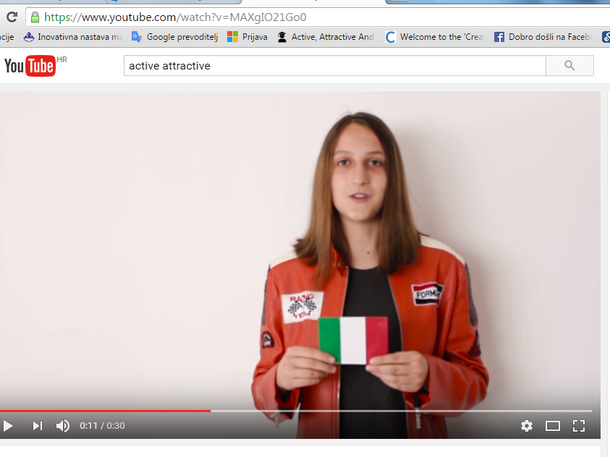








№2015-1-BG01-KA201-014198
Active, Attractive And Interactive eU Mathematics
Report-may
Europe Day 9.5.2016.
Audio-visual material: students saying the same sentence on 8 languages of countries that are in the project
https://www.youtube.com/watch?v=MAXgIO21Go0

Slide 2
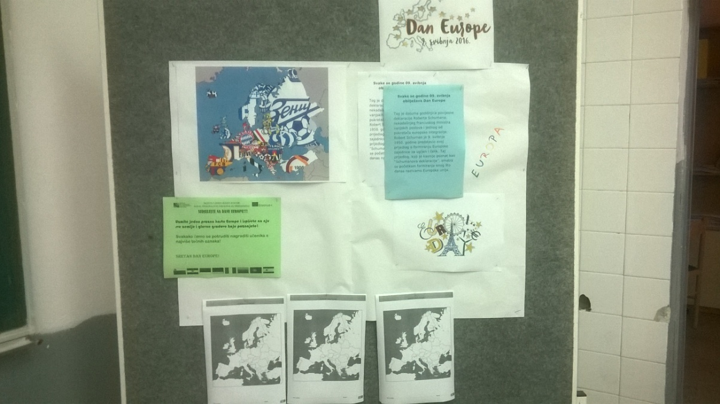
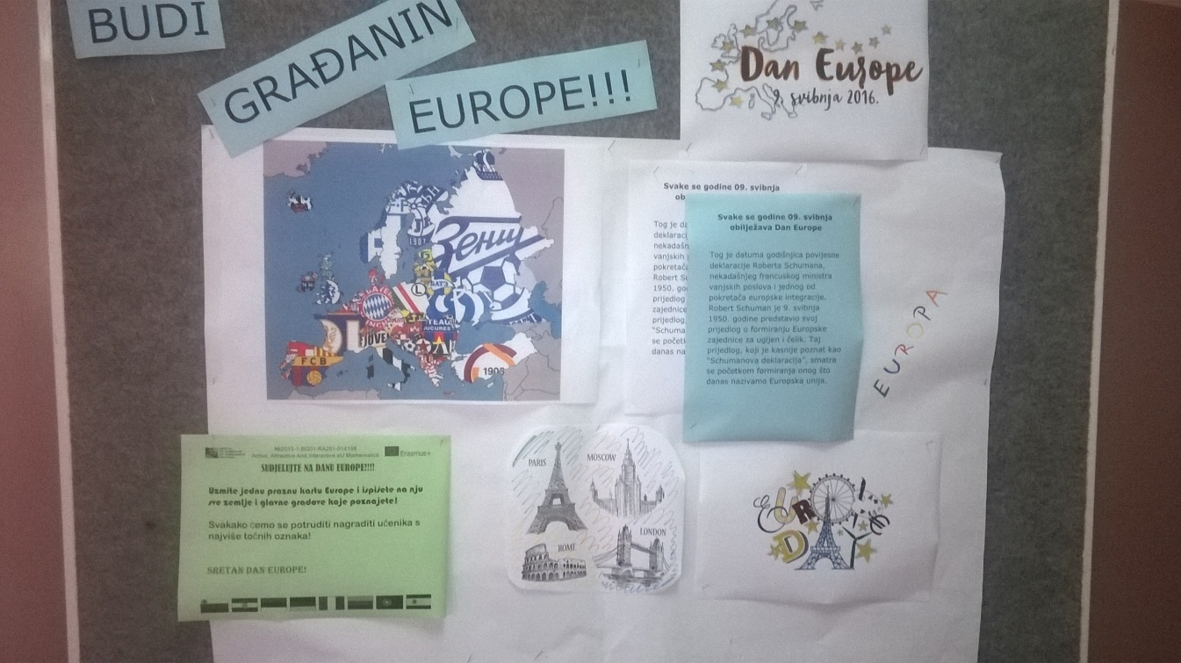
№2015-1-BG01-KA201-014198
Active, Attractive And Interactive eU Mathematics
Europe Day 9.5.2016.
b) Corner about Europe day
-historical explanation of a date,
made by student

Slide 3
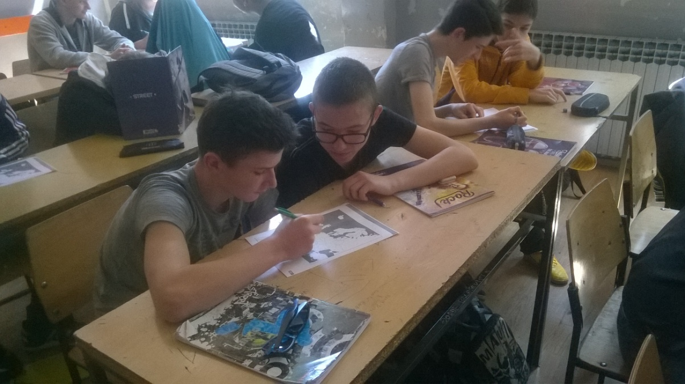
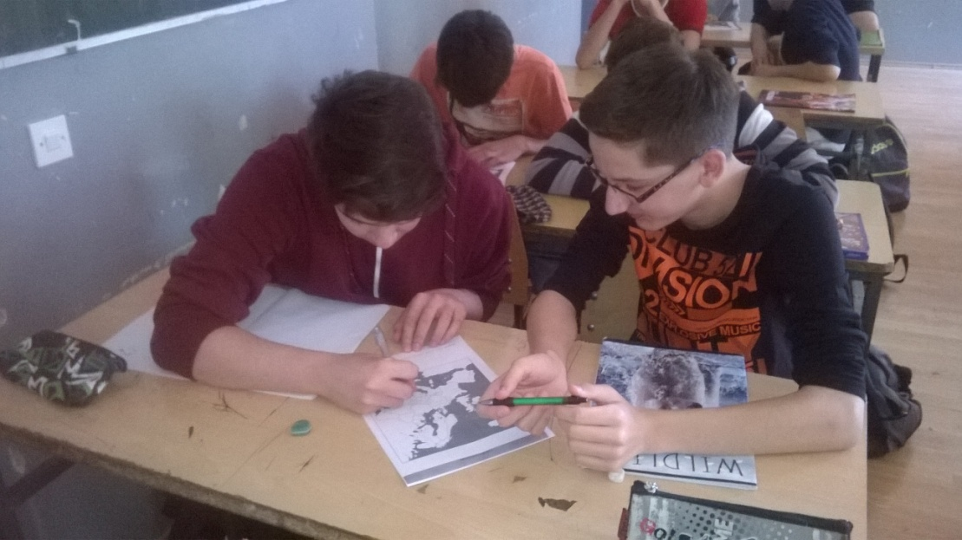
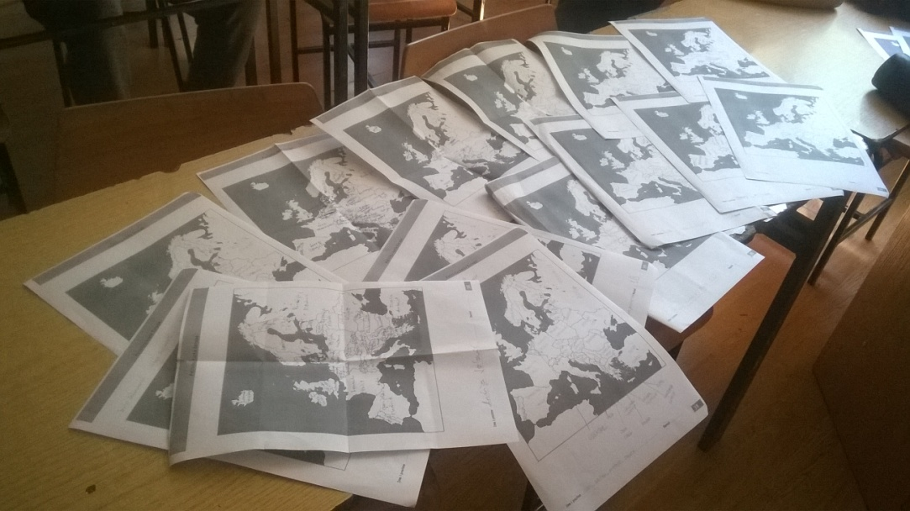
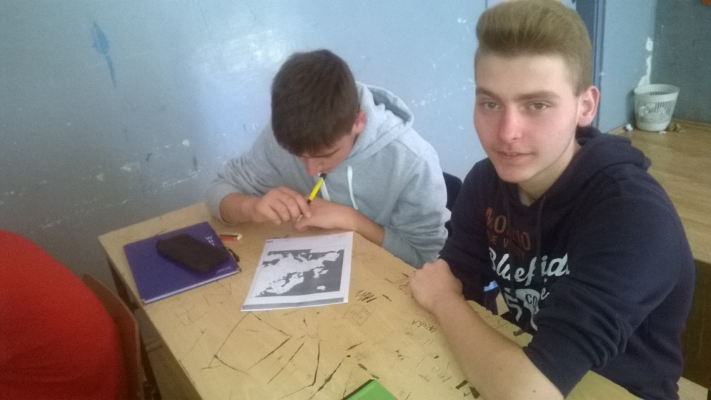
№2015-1-BG01-KA201-014198
Active, Attractive And Interactive eU Mathematics
2. Europe Day 9.5.2016.
Workshop: “Who knows more names of Europe countries and capitals?”
-workshop was organised in two classes
-students age is 15

Slide 4
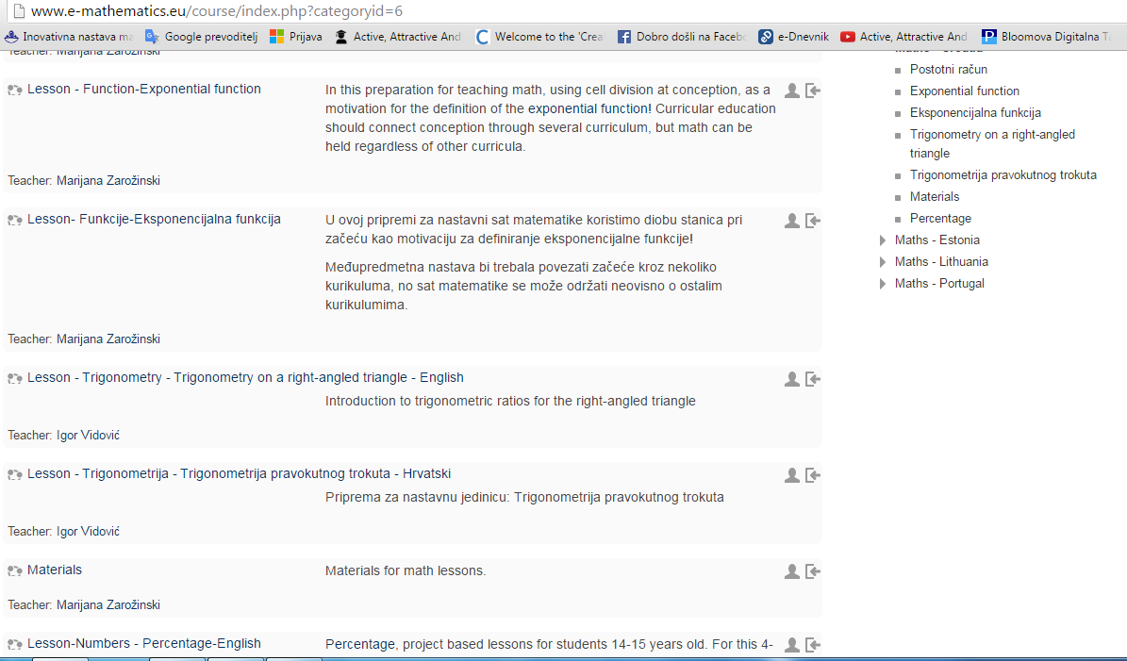
№2015-1-BG01-KA201-014198
Active, Attractive And Interactive eU Mathematics
3. Lesson plans` creation-during month
-Igor Vidović and Marijana Zarožinski creating lesson plans (third one for the first project year-exponentil function-cross curricular) and organising Croatian moodle

Slide 5
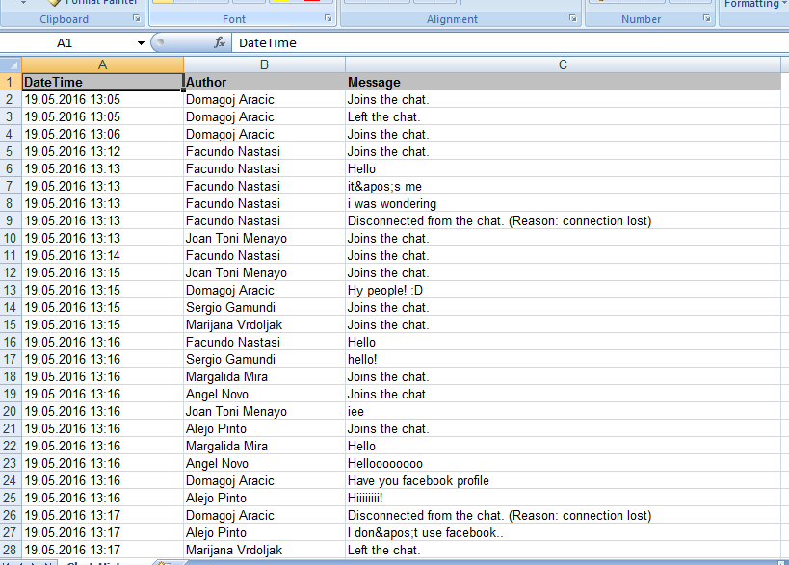
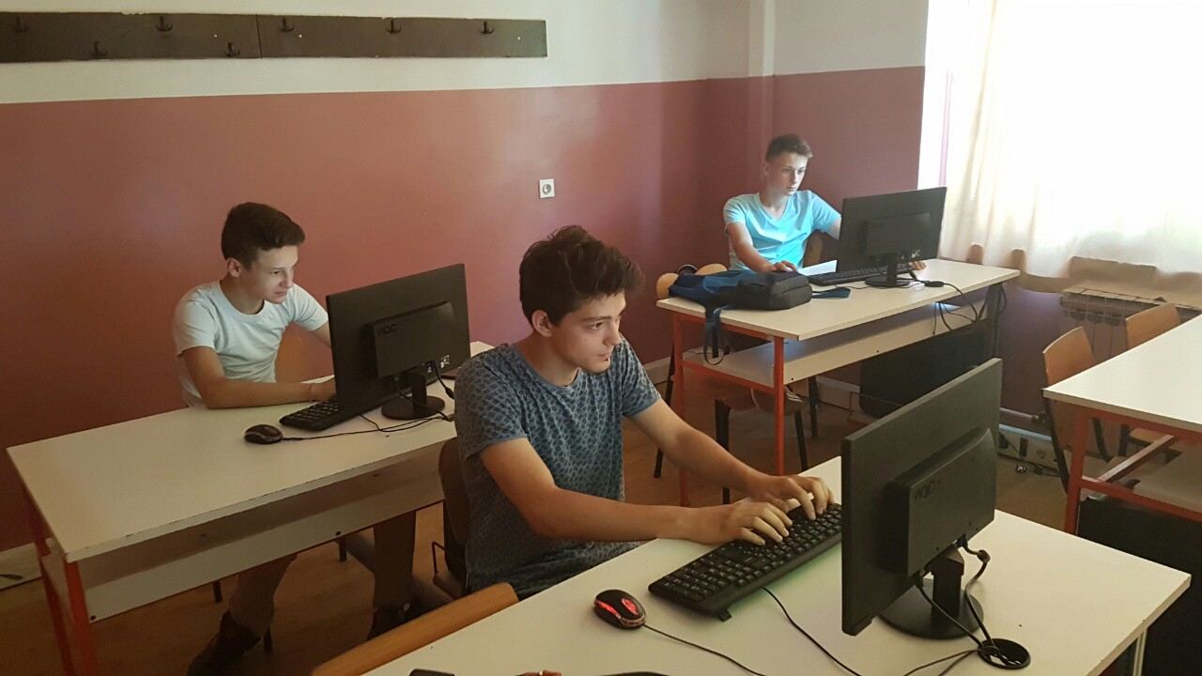
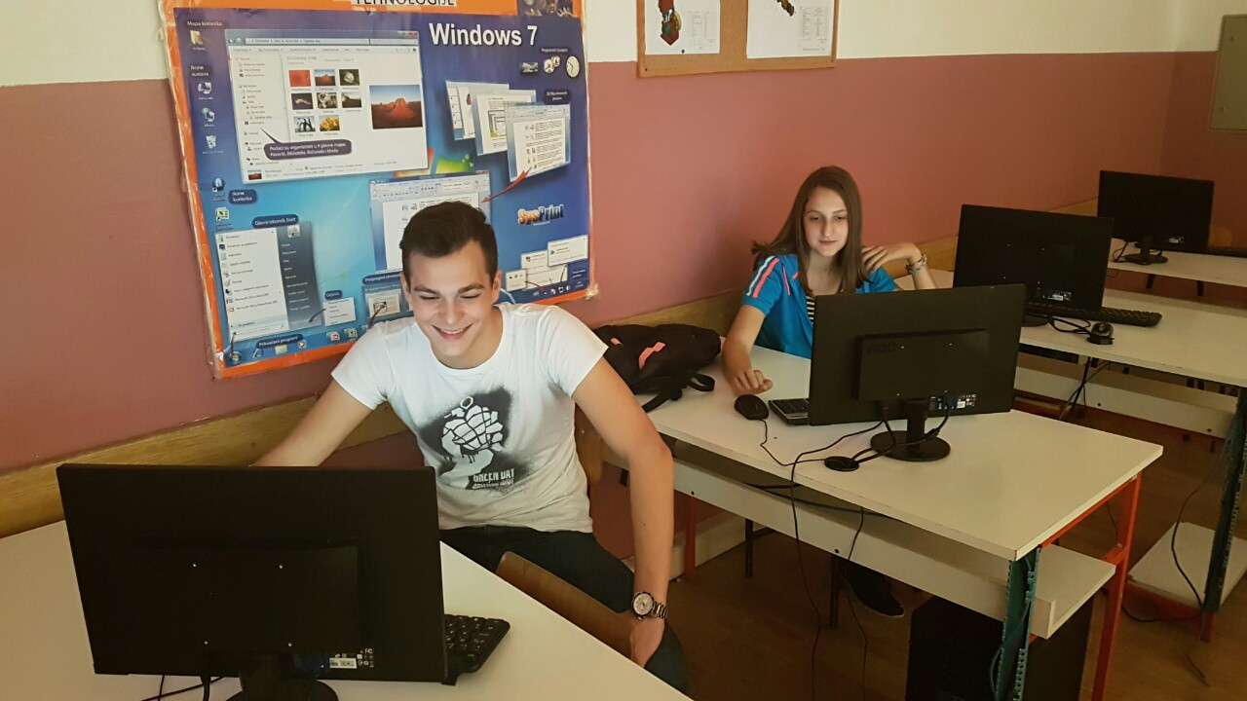
№2015-1-BG01-KA201-014198
Active, Attractive And Interactive eU Mathematics
4. Student virtual mobility on Twinspace-1.time-19.5.2016., 13.00-14.00, with Spanish students

Slide 6
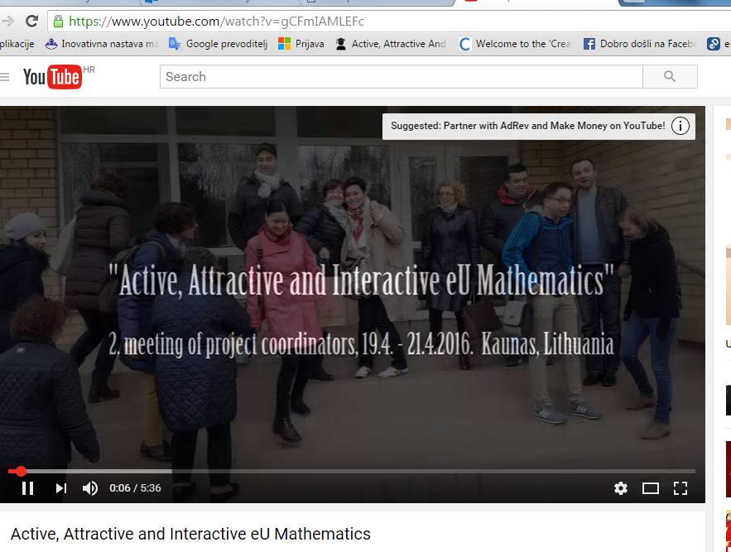
№2015-1-BG01-KA201-014198
Active, Attractive And Interactive eU Mathematics
5. You tube maintaining: Europe day movie creation and publishing and pictures-movie of meetinig in Lithuania
https://www.youtube.com/watch?v=gCFmIAMLEFc

Slide 7
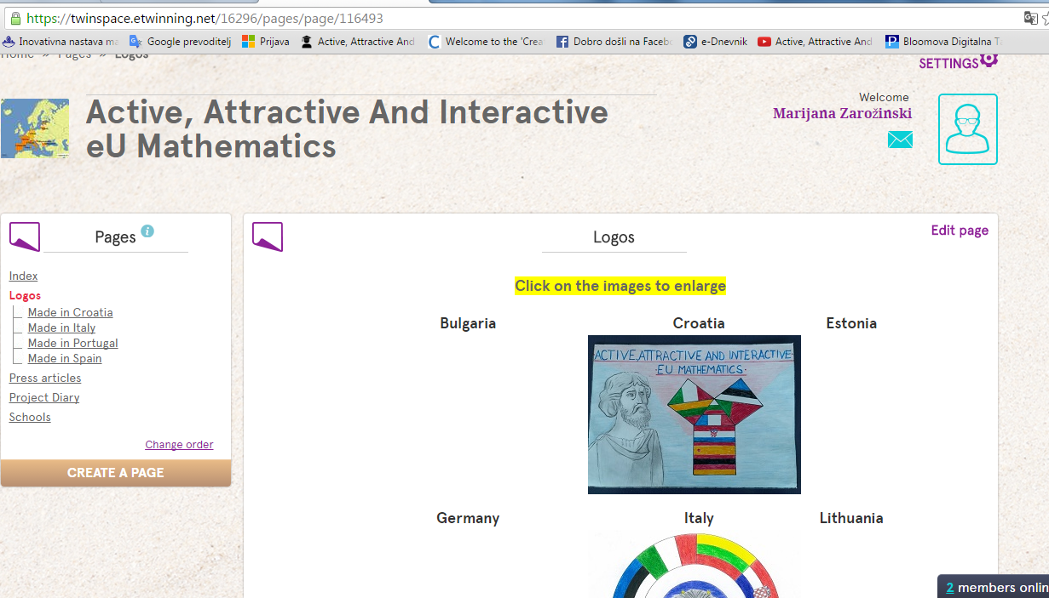
№2015-1-BG01-KA201-014198
Active, Attractive And Interactive eU Mathematics
6. Twinspace update

Slide 8
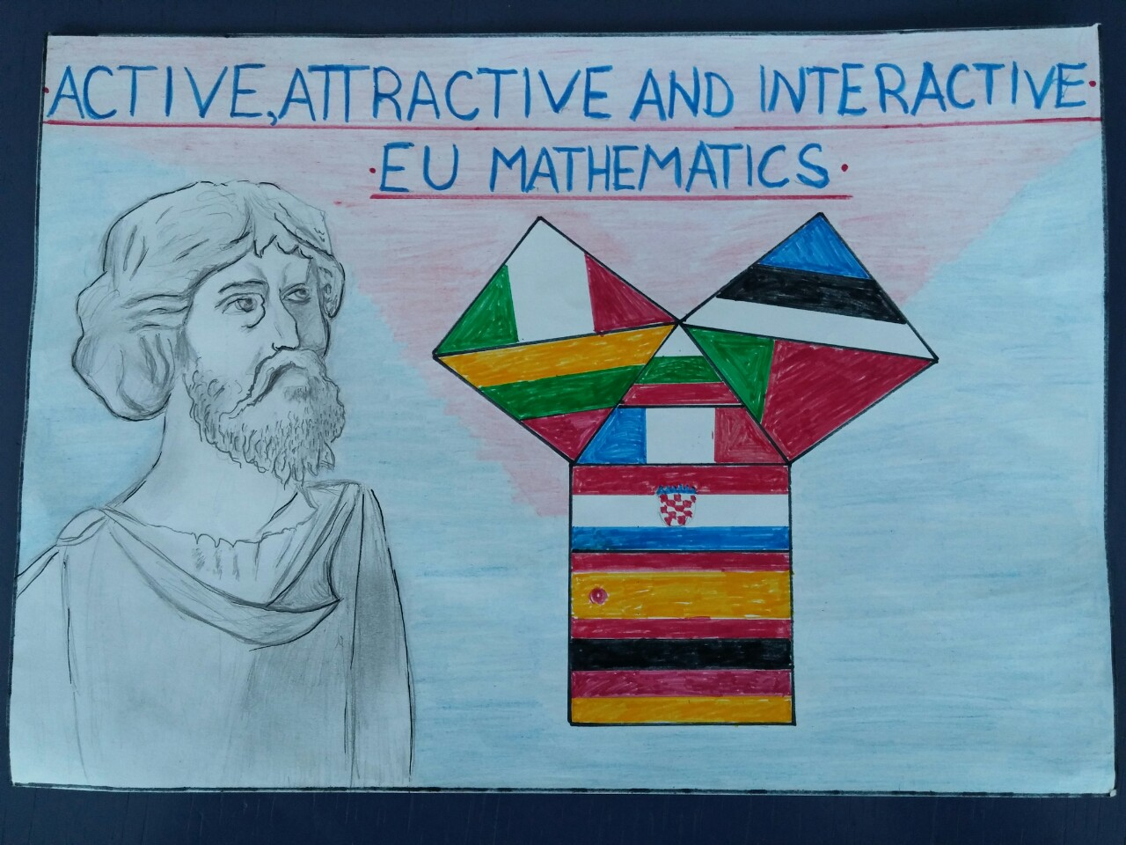
№2015-1-BG01-KA201-014198
Active, Attractive And Interactive eU Mathematics
7. Logo for the project-created by student Josip Papazovic

