Slide 1


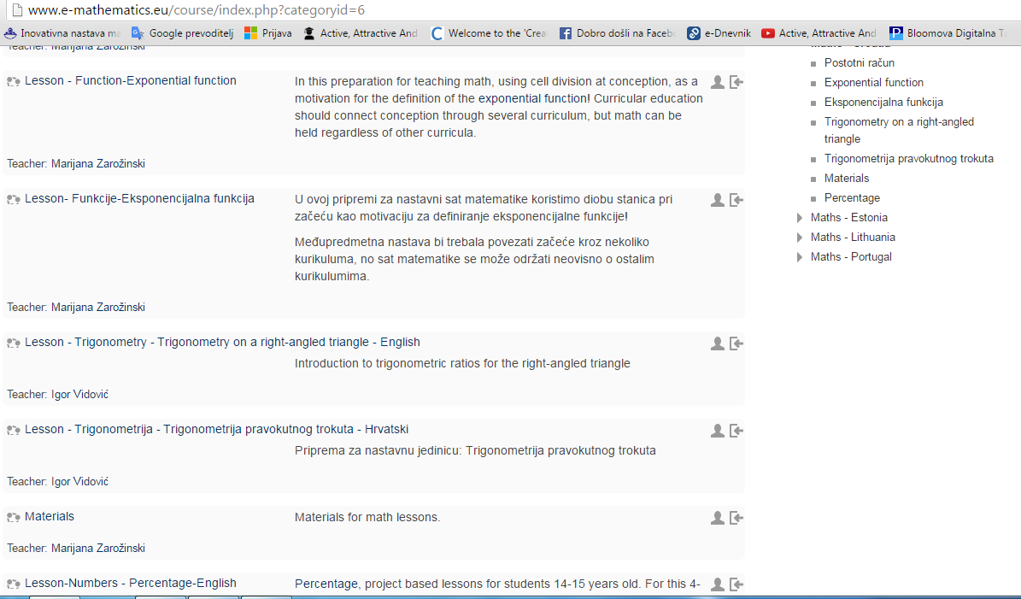








№2015-1-BG01-KA201-014198
Active, Attractive And Interactive eU Mathematics
Report-june
1. Working on moodle platform-Marijana Zarožinski i Igor Vidović

Slide 2
№2015-1-BG01-KA201-014198
Active, Attractive And Interactive eU Mathematics
2. Meetinig of project team to define components of the workshop
3. Organising workshop in our school
4. Approval of the Nacional Agency of Education, Osijek:
-Workshop in Industrial and Trade High School will be supported
by the National Agency of Education
5. Application for holding lectures and workshops on the National conference of teachers of mathematics that will be held on 25.8.-26.8.2016. in Osijek
-Marijana Zarožinski is going to hold lecture about project-dissemination of project and workshop about Kahoot!

Slide 3
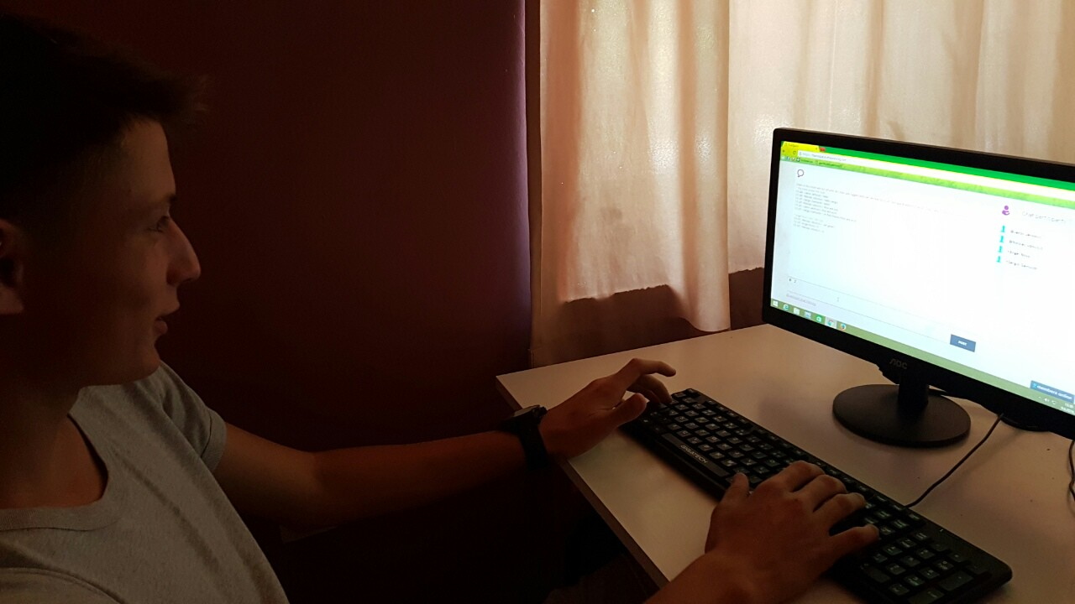
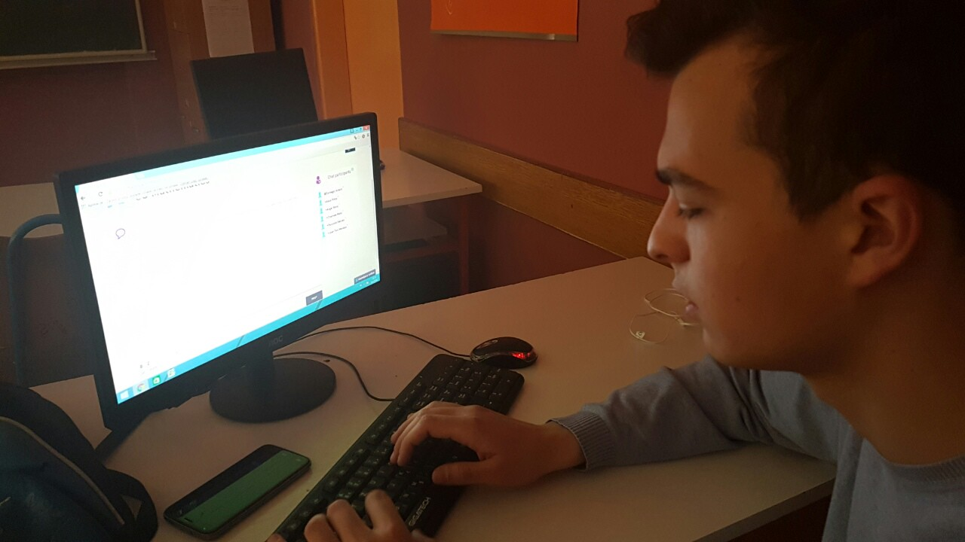
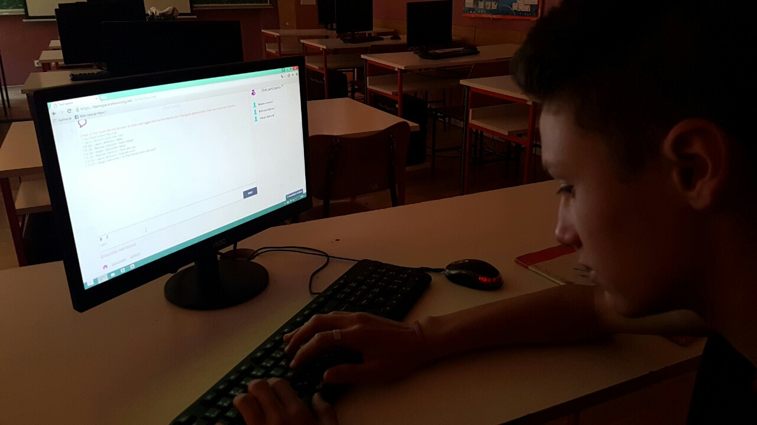
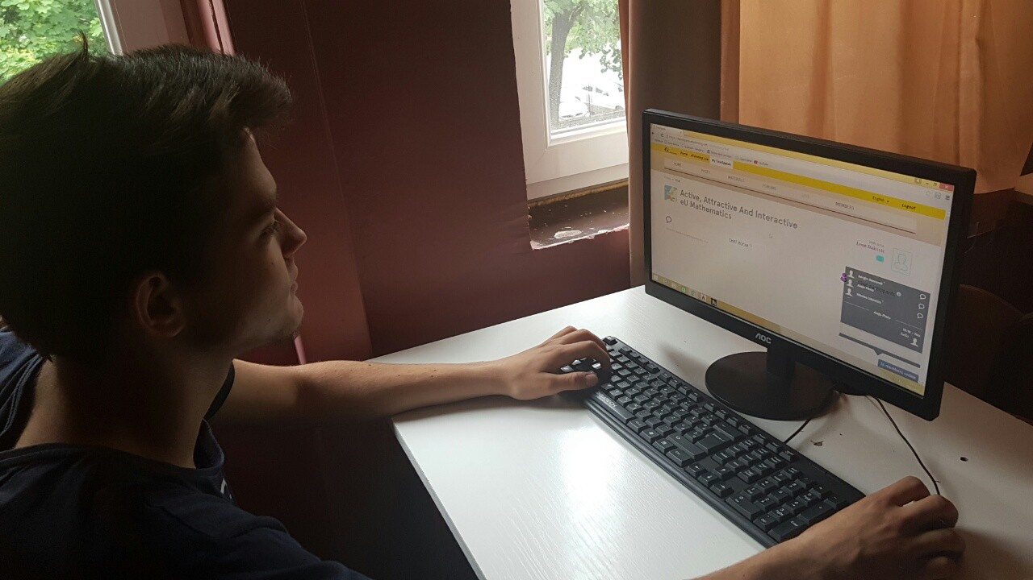
№2015-1-BG01-KA201-014198
Active, Attractive And Interactive eU Mathematics
6. Student’s virtual mobilitiy on 2.6.2016.- conection feild, on 9.6.2016. went very well

Slide 4
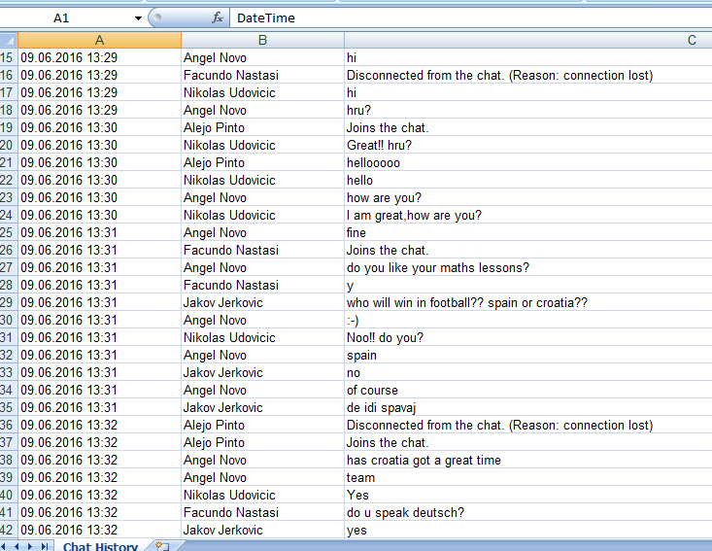
№2015-1-BG01-KA201-014198
Active, Attractive And Interactive eU Mathematics
6. Student’s virtual mobilitiy on 2.6.2016.- conection feild, on 9.6.2016. went very well
-text in excell

Slide 5
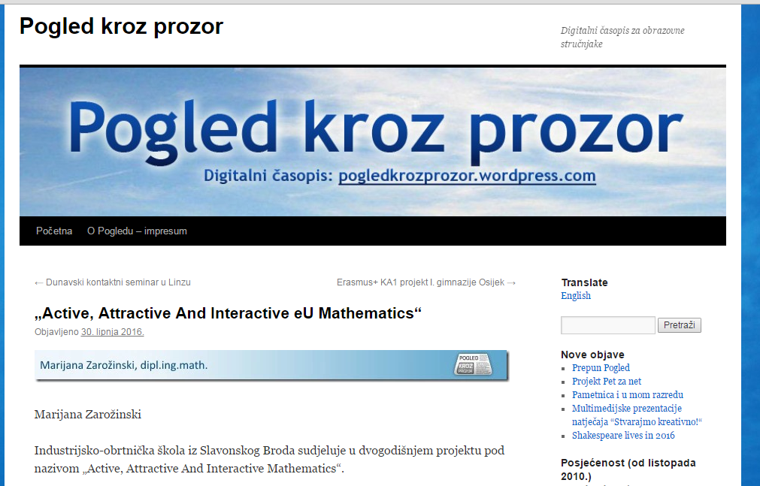
№2015-1-BG01-KA201-014198
Active, Attractive And Interactive eU Mathematics
7. Media communication, press releases, articles
Article in newsletter “Pogled kroz prozor”
https://pogledkrozprozor.wordpress.com/2016/06/30/active-attractive-and-interactive-eu-mathematics/

