Slide 1


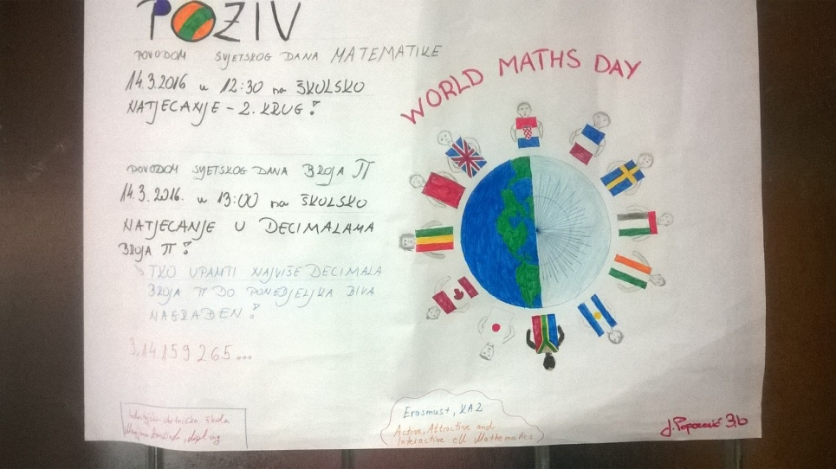
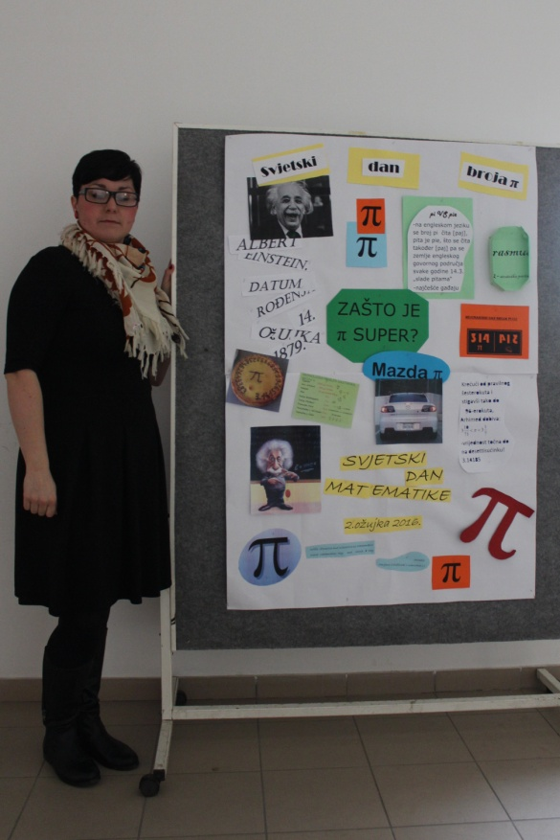
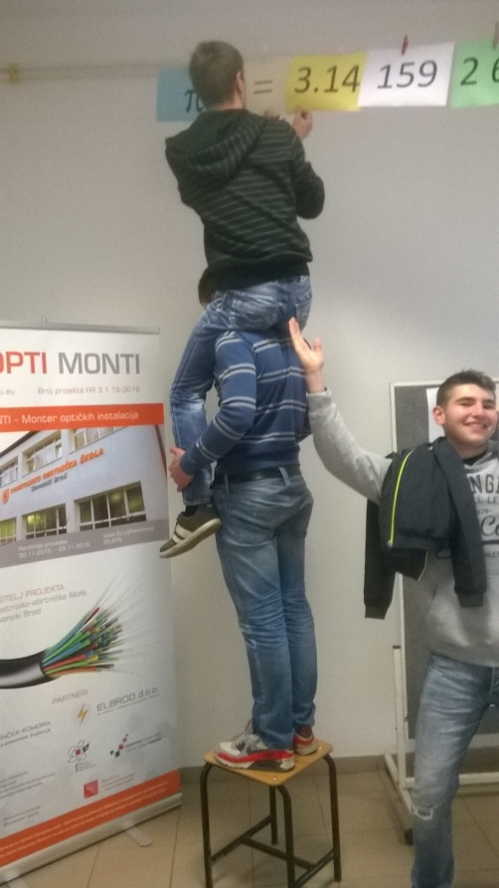
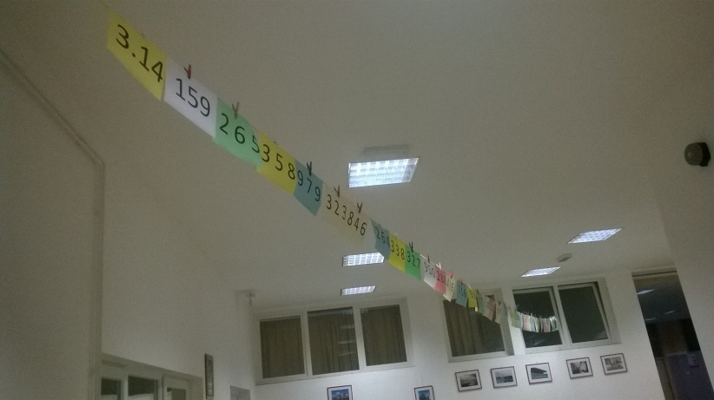








№2015-1-BG01-KA201-014198
Active, Attractive And Interactive eU Mathematics
1. World Mathematics Day in all partner schools
7.3.2016.-14.3.2016.

Slide 2
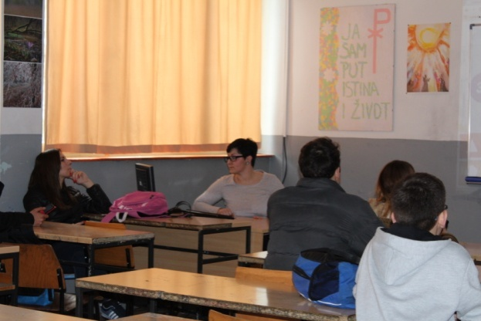
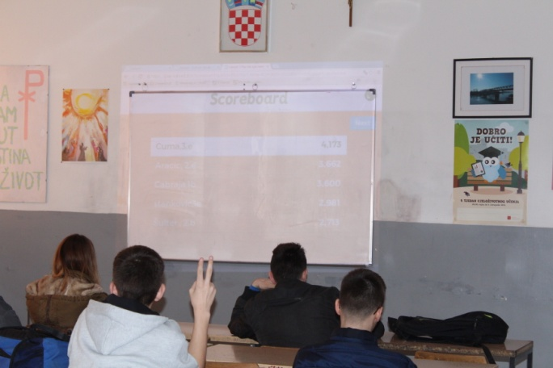
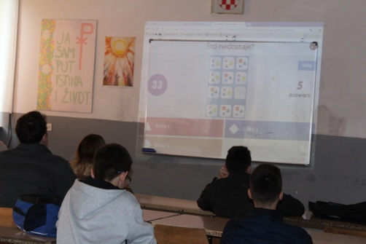
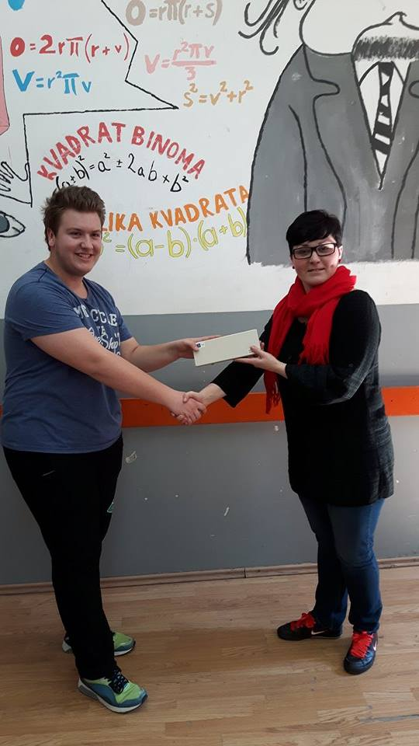
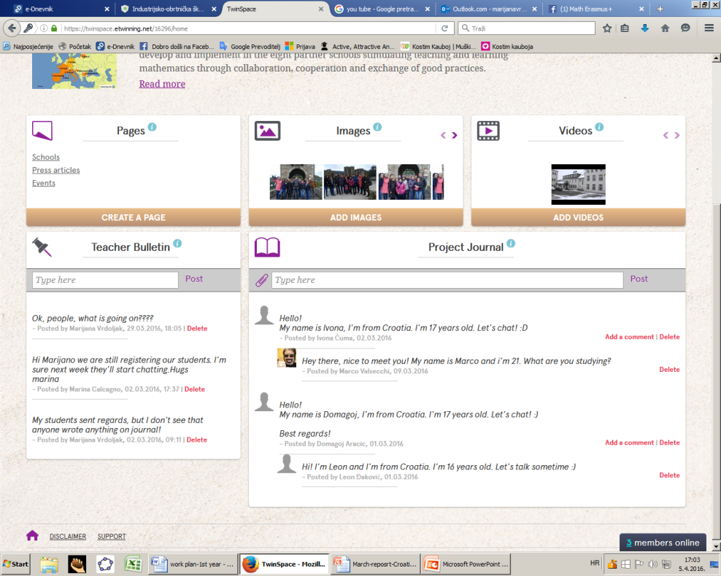
№2015-1-BG01-KA201-014198
Active, Attractive And Interactive eU Mathematics
2. Students` activities
Competetion on 14.3.2016. in Kahoot
Awarding the best student in Kahoot competetion
-competetion in decimals of PI-student from third grade (17 years) Ivona Ćuma won the competetion knowing 64 corect decimlas (don’t have a picture)
-students on Twinspace

Slide 3
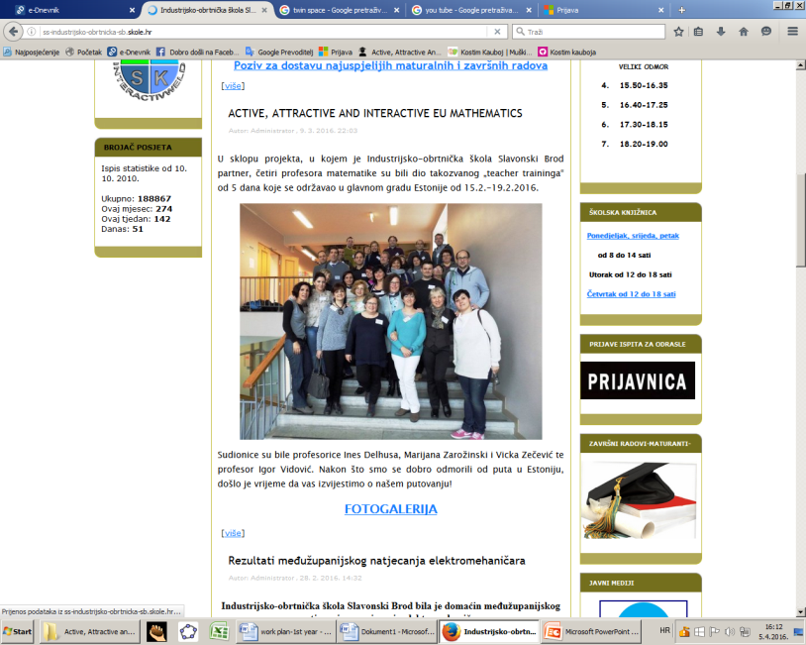
№2015-1-BG01-KA201-014198
Active, Attractive And Interactive eU Mathematics
3. Media communication, press releases, articles
Project`s web presence through social networks and on-line media
-on school web site

Slide 4
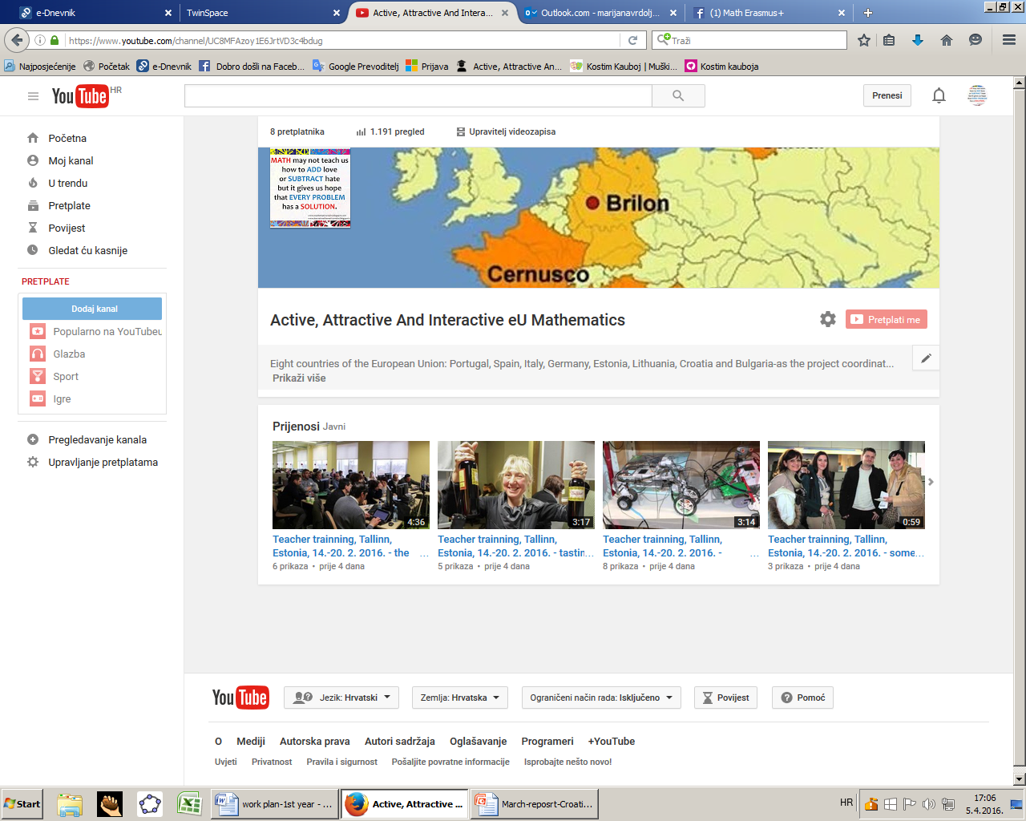
№2015-1-BG01-KA201-014198
Active, Attractive And Interactive eU Mathematics
4. Project`s web presence through social networks and on-line media
-creating slideshows for You Tube
-maintaining You Tube channel
-creating videos for moodle platform (curriculas and presentations)

Slide 5
№2015-1-BG01-KA201-014198
Active, Attractive And Interactive eU Mathematics
5. Lesson plans
-meeting of teachers-reasearchers about lesson plans (who is doing what type of a lesson)

